Slide 1


Chidananda Rao Ramiah
07/03/2023

Slide 2

Outline
Executive Summary
Introduction
Methodology
Results
Conclusion
Appendix

Slide 3
Executive Summary
Summary of methodologies
- Data Collection
- Data Wrangling
- Data Visualization
- EDA with SQL
- Building an interactive map with Folium
- Building a dashboard with Plotly Dash
- Predictive Analysis
Summary of all results
- Exploratory data analysis results
- Interactive analytics demo
- Predictive Analysis Results

Slide 4
Introduction
Project background and context
Commercial space travel has become more feasible in recent years due to advances in technology and the increasing involvement of private companies in space activities. Companies such as SpaceX have developed reusable rockets and spacecraft, which have reduced the cost of spaceflight and made it more accessible to a wider range of customers.
Our goal is to predict if SpaceX’s Falcon 9 first stage will land successfully. If we can determine if the first stage will land, we can determine the cost of a launch which should lead to valuable data during bidding wars between space travel companies.
Problems you want to find answers
- Correlation between the rocket’s variables and the successful landing rate
- Conditions to get optimal results and maximum successful landing rate

Slide 5

Section 1

Slide 6
Methodology
Executive Summary
Data collection methodology:
SpaceX API and Web Scraping from Wikipedia
Perform data wrangling
Outcomes were converted into labels for training.
Perform exploratory data analysis (EDA) using visualization and SQL
Perform interactive visual analytics using Folium and Plotly Dash
Perform predictive analysis using classification models
Finding the best hyperparameter for SVM, Classification Trees and Logistic Regression

Slide 7
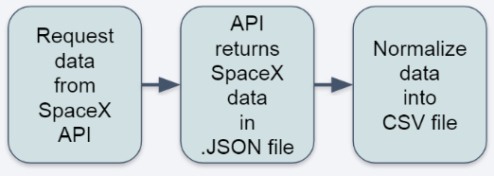
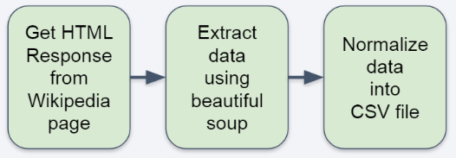
Data Collection
The data collection process includes several API requests from the SpaceX API and web scraping data from the Wikipedia page of the Falcon 9 launch records.
- SpaceX API Data Columns:
FlightNumber, Date, BoosterVersion, PayloadMass, Orbit, LaunchSite, Outcome, Flights, GridFins, Reused, Legs, LandingPad, Block, ReusedCount, Serial, Longitude, Latitude.
- Wikipedia Web Scrape Data Columns:
Flight No., Launch Site, Payload, PayloadMass, Orbit, Customer, Launch outcome, Version Booster, Booster landing, Date, Time.
SpaceX API Web Scraping

Slide 8
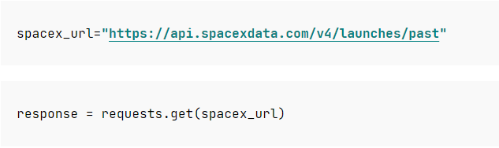
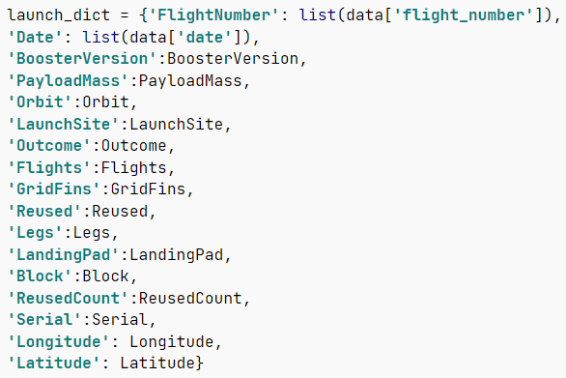
Data Collection – SpaceX API
Request rocket launch data from SpaceX API.
2. Converting response into a JSON file.
Use custom functions to clean data.
GitHub Link
4. Combining columns into a dictionary to create a data frame.
5. Filtering dataframe and exporting to CSV

Slide 9
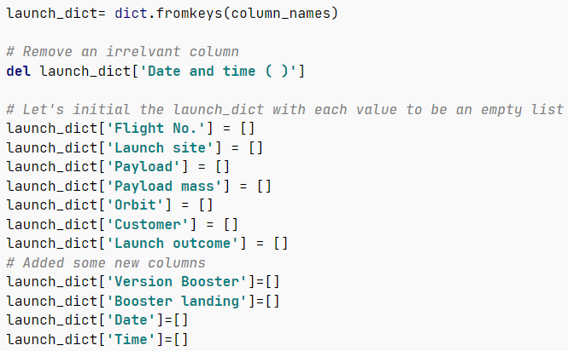
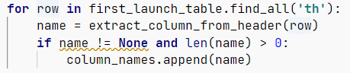
Data Collection – Scraping
1. Getting response from HTML.
2. Converting response into a JSON file.
3. Finding all tables and assigning the result to a list.
4. Extracting columns one by one.
GitHub Link
5. Creating an empty dictionary with keys.
6. Creating a dataframe and exporting it to CSV.

Slide 10
Data Wrangling
There are several cases in cases in which the booster failed to successfully land on the dataset, and sometimes it attempted to land but failed because of accident.
- True Ocean: the mission result has successfully landed in a specific area of the ocean.
- False Ocean: the mission result has not successfully landed in a specific area of the ocean.
- True RTLS: the mission result has successfully landed on the ground pad.
- False RTLS: the mission result has not successfully landed on the ground pad.
- True ASDS: the mission result has successfully landed on the drone ship.
- False ASDS: the mission result has not successfully landed on the drone ship.
Converting these results into training labels:
- 1= successful/ 0 = failure
GitHub Link

Slide 11
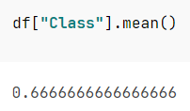
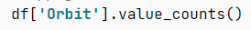
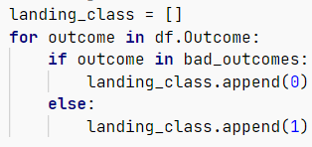
Data Wrangling
1. Calculating the number of launches per site
2. Calculating the number and occurrence of each orbit.
3. Calculating the number and occurrence of mission outcome per orbit type.
4. Creating a landing outcome label from Outcome column.
5. Calculating the success rate for every landing in the dataset.
6. Exporting dataset to CSV.
GitHub Link

Slide 12
Data Visualization
Scatter chart:
- Flight Number vs. Launch Site
- Payload vs. Launch Site
- Flight Number vs. Orbit Type
- Payload vs. Orbit Type
Bar Chart:
- Orbit Type vs. Success Rate
- A bar chart makes the dataset comparison more explicit. One axis represents a categorical value and the other axis represents a discrete value. The goal of the chart is to indicate the relationship between the 2 axes.
Line Chart:
- Year vs. Success Rate
- A Line chart shows data variables an trends very clearly and helps predict the results of data that is yet to be recorded.
GitHub Link

Slide 13
EDA with SQL
Loading the dataset into the corresponding table in a Db2 database and executing SQL queries to answer the following questions.
- Displaying the names of unique launch sites in the space missions.
- Displaying 5 records where launch sites begin with ‘CCA’.
- Displaying the total payload mass carried by boosted launched by NASA.
- Displaying the average payload mass carried by boosted version F9 v1.1.
- Listing the date when the first successful landing outcome in ground pad was achieved.
- Listing the names of the boosters which have success in drone ship and have payload mass between 4000 and 6000.
- Listing the total number of successful and failure mission outcomes.
- Listing the names of the booster versions which have carried the maximum payload mass
- Listing the failed landing outcomes in drone ships, their booster versions, and launch site names in 2015.
- Ranking the count of landing outcomes (such as Failure (drone ship) or Success(ground pad)) between the dates 2010-06-04 and 2017-03-20, in descending order.
GitHub Link

Slide 14
Build an Interactive Map with Folium
Objects created and placed on the Folium Map.
- Markers that show all launch sites on a map.
- Markers that show the success/failed launches for each site on the map.
- Lines that show the distances between a launch site to its proximities.
By adding these objects, following geographical patterns about launch sites and found:
- Are launch sites in close proximity to railway systems? Yes
- Are launch sites in close proximity to highways? Yes
- Are launch sites in close proximity to the coastline? Yes
- Do launch sites keep certain distance away from cities? Yes
Interactive Maps URL

Slide 15
Build a Dashboard with Plotly Dash
The dashboard application contains a pie chart and a scatter plot chart.
- Pie Chart:
Shows total number of successful launches by sites.
Indicates the successful landing distribution across all sites or to indicate the success rate of each launch site.
- Scatter Plot
Shows the relationship between Outcomes and Payload Mass with different boosters
Has 2 inputs namely the launch site and payload mass
Visualizes the dependency between payload mass, launch point and booster version
GitHub Link

Slide 16
Predictive Analysis (Classification)
BUILD MODEL
Perform EDA (Classification) and choose training labels.
- Separate class into column
- Standardize the data
- Split the data into training and test sets
Find the best hyperparameter for SVM, Classification Trees and Logistic Regression.
- Find the method that has the best performance using test data.
GitHub Link
BUILD MODEL
IMPROVE MODEL
FIND THE BEST PERFORMING CLASSFICATION MODEL

Slide 17
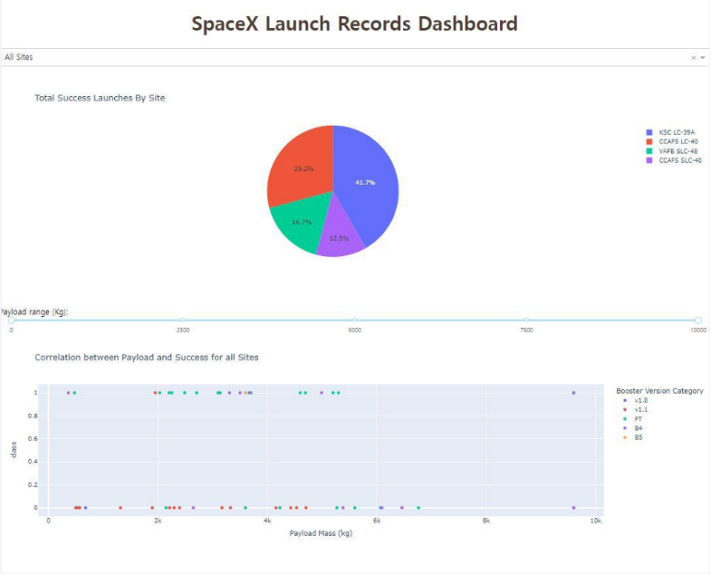
Results
The left screenshot shows the Dashboard with Plotly Dash.
The results of EDA with visualization, EDA with SQL, Folium Map and Dashboard will be shown in the following slides.
Comparing the accuracy of all four classification methods, all return the same accuracy of approximately 83% on the test data.

Slide 18

Section 2

Slide 19
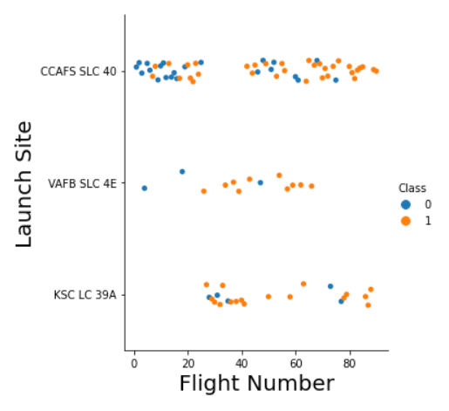
Flight Number vs. Launch Site
Class 0 indicates an unsuccessful launch while Class 1 represents a successful launch.
The adjacent scatterplot indicates that the success rate of flights increased the number of flights.
The 20th flight can be seen as a breakpoint as the success rate increased tremendously following that point.

Slide 20
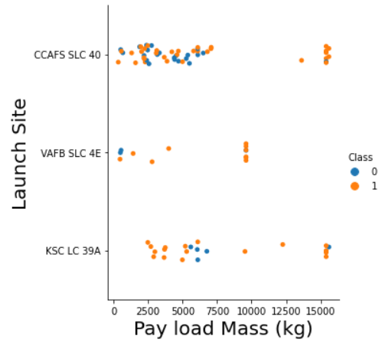
Payload vs. Launch Site
Class 0 indicates an unsuccessful launch while Class 1 represents a successful launch.
It may be inferred that at higher payload masses the success rate is higher but the volume of these flights is limited and thus we cannot draw a clear correlation between success rate and Payload Mass.

Slide 21
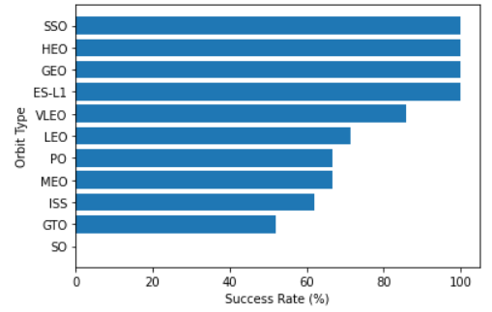
Success Rate vs. Orbit Type
Orbits of type SSO, HEO, GEO, and ES-L1 have the highest success rates (100%).
While, GTO exhibits a success rate of only 50% and SO exhibits the lowest success rate with 0%.

Slide 22
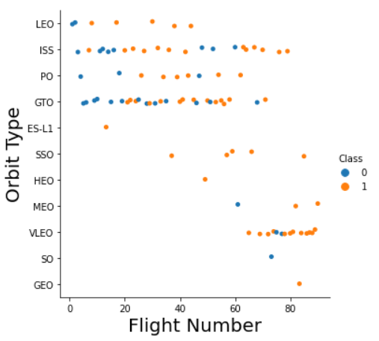
Flight Number vs. Orbit Type
Class 0 indicates an unsuccessful launch while Class 1 represents a successful launch.
The launch outcome shows some correlation with varying number of flights. GTO and ISS show signs of not conforming with that pattern.
The LEO and VLEO orbits seem to have the highest success rate and seem to have been identified by SpaceX as the most effective orbit type.

Slide 23
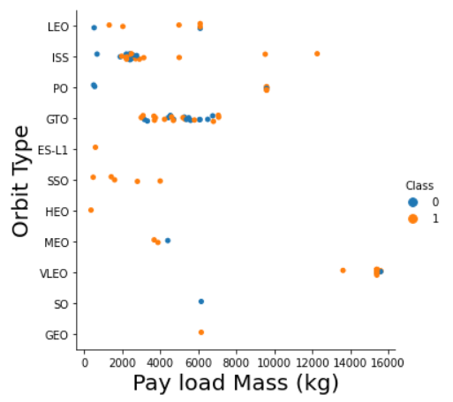
Payload vs. Orbit Type
Class 0 indicates an unsuccessful launch while Class 1 represents a successful launch.
The heavier payloads have mostly used the VLEO orbit and show a hig success rate.
The GTO orbit type shows little correlation between landing success rate and payload mass.

Slide 24
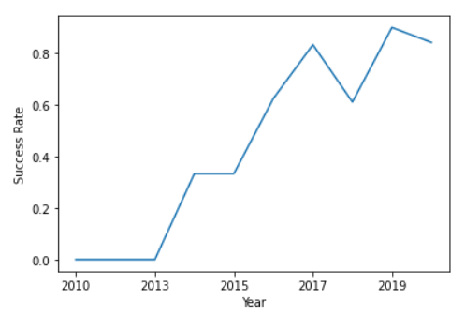
Launch Success Yearly Trend
We can clearly see that 2015 onwards was a time of great advancement for success rate trends.
2018 exhibited an unusual dip in success rate.
Current rates exhibit about 80% of success.

Slide 25
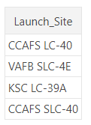
All Launch Site Names
Query :
SELECT DISTINCT LAUNCH_SITE
FROM SPACEXTBL
Result
DISTINCT selects only unique values in the Launch_Site column from the SpaceX table.

Slide 26
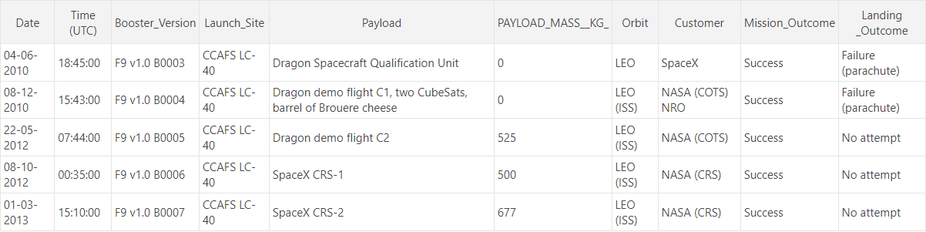
Launch Site Names Begin with 'CCA'
Query :
SELECT * FROM SPACEXTBL
WHERE LAUNCH_SITE LIKE ‘CCA%’
LIMIT 5
Result
LIMIT 5 displays only 5 records from the SpaceX table.
LIKE and the % sign, allows us to search for a Launch_Site starting with CCA.

Slide 27
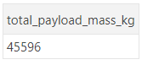
Total Payload Mass
Query :
SELECT SUM(PAYLOAD_MASS__KG_) AS total_payload_mass_kg
FROM SPACEXTBL
WHERE CUSTOMER = ‘NASA (CRS)’
Result
SUM() calculates the sum of the column PAYLOAD_MASS_KG_.

Slide 28
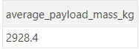
Average Payload Mass by F9 v1.1
Query :
SELECT AVG(PAYLOAD_MASS__KG_) AS average_payload_mass_kg
FROM SPACEXTBL
WHERE BOOSTER_VERSION= ‘F9 v1.1’
Result
AVG() calculates the average value of PAYLOAD_MASS__KG_.

Slide 29
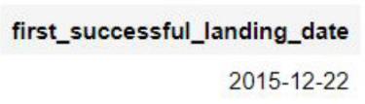
First Successful Ground Landing Date
Query :
SELECT MIN(DATE) AS first_successful_landing_date
FROM SPACEXTBL
WHERE LANDING_OUTCOME = ‘Success (ground pad)’
Result
MIN() finds the earliest date in the column date.

Slide 30
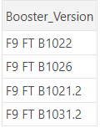
Successful Drone Ship Landing with Payload between 4000 and 6000
Query :
SELECT BOOSTER_VERSION FROM SPACEXTBL
WHERE LANDING_OUTCOME = ‘Success (drone ship)’ AND (PAYLOAD_MASS__KG_ BETWEEN 4000 AND 6000)
Result
AND allows us to select an additional condition PAYLOAD_MASS__KG_.

Slide 31
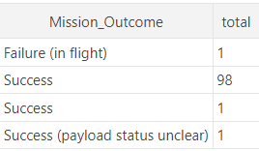
Total Number of Successful and Failure Mission Outcomes
Query :
SELECT MISSION_OUTCOME, COUNT(*) AS total
FROM SPACEXTBL
GROUP BY MISSION_OUTCOME
Result
COUNT() calculates the total number of columns
GROUP BY groups rows that have the same Mission_Outcome to find the total of these columns.
The result shows that SpaceX has completed nearly 99% of all of its missions.

Slide 32
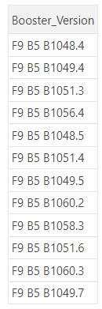
Boosters Carried Maximum Payload
Query :
SELECT DISTINCT BOOSTER_VERSION
FROM SPACEXTBL
WHERE PAYLOAD_MASS__KG_ = (
SELECT MAX(PAYLOAD_MASS__KG_)
FROM SPACEXTBL);
We use a subquery to first find the MAX() payload and secondly searching which Boosters carry the determined maximum payload.
Result :

Slide 33
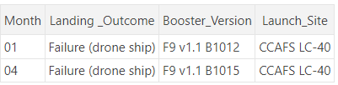
2015 Launch Records
Query :
SELECT substr(Date,4,2) as Month, LANDING_OUTCOME, BOOSTER_VERSION, LAUNCH_SITE
FROM SPACEXTBL
WHERE LANDING_OUTCOME = ‘Failure (drone ship)’ AND substr(Date,7,4) = '2015’
Using WHERE and AND we state 2 conditions which need to be satisfied for our query.
We use the substr function to obtain the month since SQLLite does not support YEAR/MONTH functions.
Result :

Slide 34
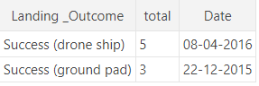
Rank Landing Outcomes Between 2010-06-04 and 2017-03-20
Query :
SELECT LANDING_OUTCOME, COUNT(LANDING_OUTCOME) AS total, DATE
FROM SPACEXTBL
WHERE substr(Date,7,4) || substr(Date,4,2)
|| substr(Date,1,2) BETWEEN '20100604’ AND '20170320’ AND "Landing _Outcome" LIKE "Success%"
GROUP BY "Landing _Outcome"
ORDER BY total DESC
Result:
ORDER BY allows us to put the results in descending order

Slide 35

Section 3

Slide 36
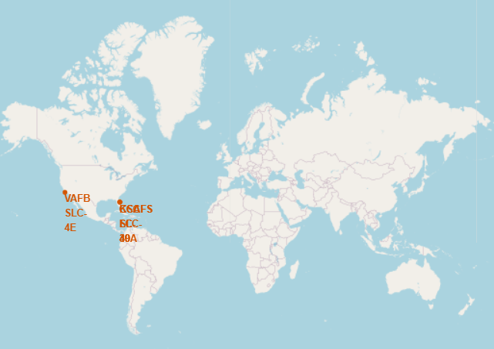
All Launch Sites Location on Folium Map
All launch sites are in the United States.
All launch sites are near the coast.

Slide 37
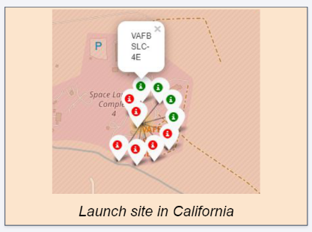
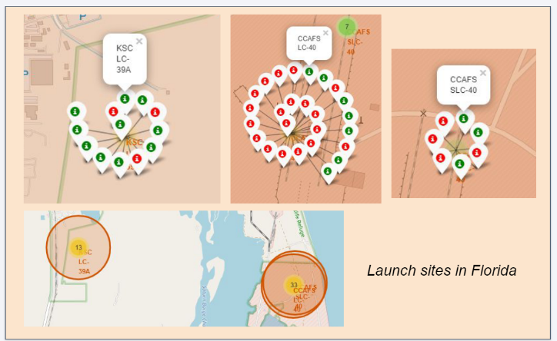
Color-labeled Launch Outcomes
The successful and failed landings are distinguished by green and red respectively.

Slide 38
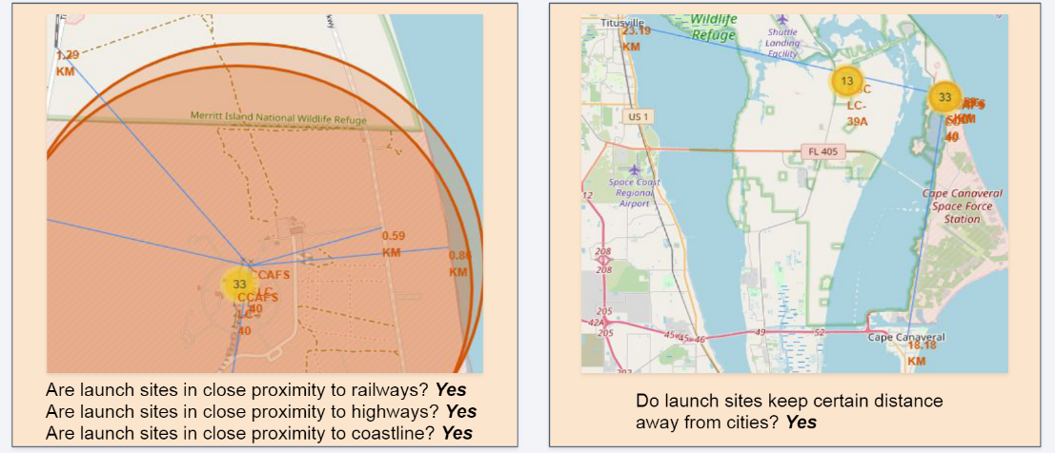
Proximity of Launch Sites
The launch sites are close to the coastline and far from cities so that launch failures do not create catastrophic events.

Slide 39

Section 4

Slide 40
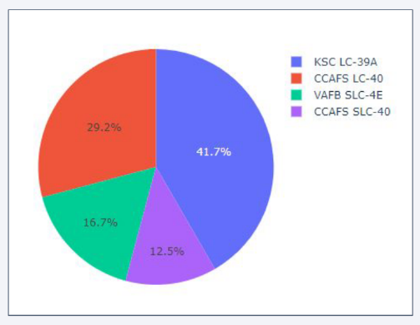
Successful Launches order by sites
KSLC-39A is the site with the most launches.
VAFB SLC-4E has the lowest launch success and is the only west coast launch site.
It can be inferred that the east coast has favorable conditions for launches by the greater number of attempts and successes.

Slide 41
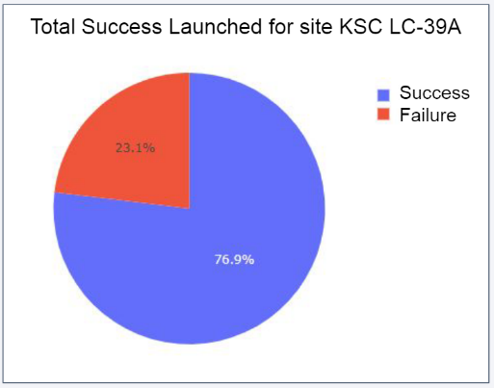
Launch Site with Highest Launch Success Rate
KSLC-39A has the highest rate with 10 successful landings.

Slide 42
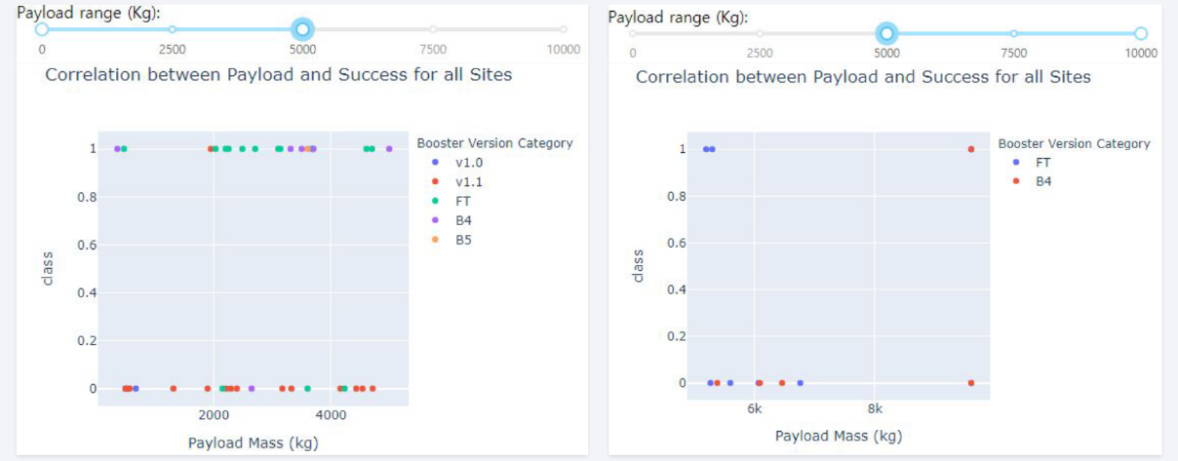
Payload vs. Launch Outcome Scatter Plots
The scatter plots show that the success rate (class 1) for low-weighted payloads is higher than that of higher-weighted payloads.

Slide 43

Section 5

Slide 44
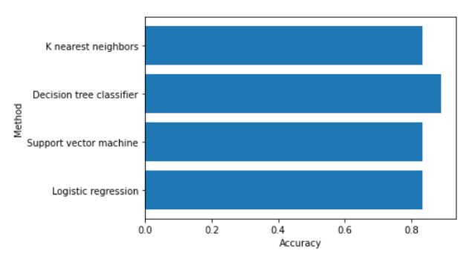
Classification Accuracy
In the test test, all models produced an accuracy of about 83.3%.
The test set was relatively small at 18.
A larger training set could result in more reliable results.

Slide 45
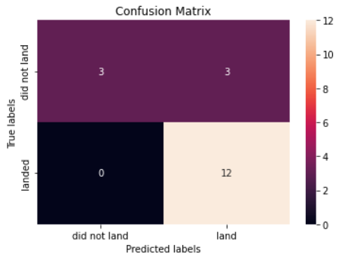
Confusion Matrix
The confusion matrix is basically the same for all models on the same test set.
All models predicted 12 successful landings when true label was successful and 3 failed landings where the true label was failure.
There are also 3 predictions for 3 successful landings when the reality was that those were failed landings(false positive).
We can imply that the models correctly predict successful landings.

Slide 46
Conclusions
The success rate increased with a rise in number of flights and recently stagnated at the 80% mark. This is likely due to the use of practical data to improve future launches.
Orbit types SSO, HEO, GEO, AND ES—L1 have a success rate of 100%.
The launch sites are close to railways, highways, and coastlines, but far from cities.
KSLC-39A has the highest number of launch successes and the highest success rate among all sites.
The launch success rate of low-weighted payloads is higher than that of heavy-weighted payloads.
In this dataset, all the classification models produce the same accuracy of 83%. However, this result is based on a relatively small dataset.

Slide 47
Appendix
GitHub Repository URL

Slide 48


